Slide 1
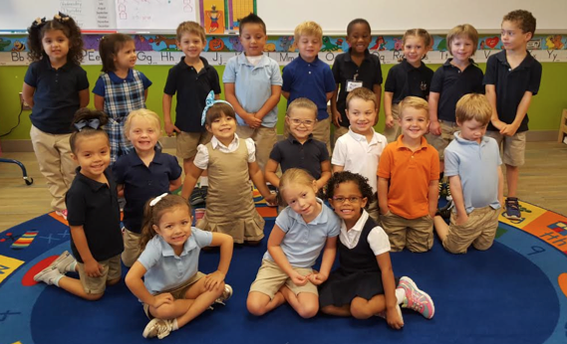
Mrs. Stephenson’s pre-k
Back to school night
John rex charter elementary school

Slide 2
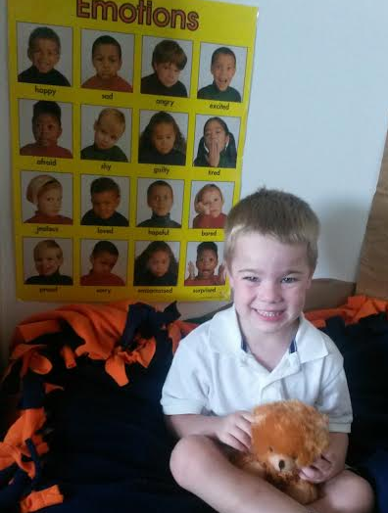
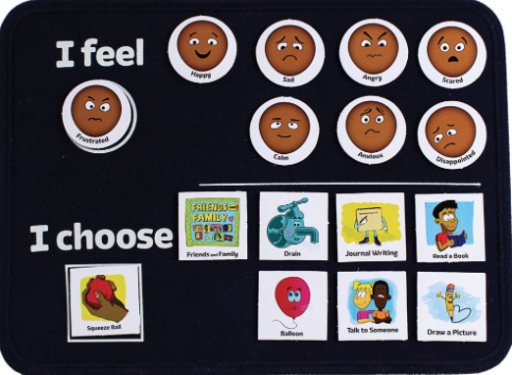
Responsive Classroom
Conduct “morning meetings” to create a sense of community.
Provide a place where students feel physically and emotionally safe
Develop self discipline skills for working and learning together
Conscious Discipline
Notes:
The Responsive Classroom approach is a way of creating a school climate that enables optimal academic and social growth. This approach ensures positive behavior and productive learning is taking place throughout the school, not just when the students are in my class. Our goal is that all students feel physically and emotionally safe in the school and develop self discipline skills for working and learning together.
We are using this approach to ensure consistent behavior expectations of all students, teaching positive behavior to all students, and establishing school wide procedures for misbehavior.
Conscious Discipline is on back order but when it comes in you will hear more from me and your child about this program. This is the choice board which will be located in our Safe Place. The Safe Place is an area in the room for students to calm down or just be alone when they are sad. Please send in a family photo for us to display in this area. The choices are different calming techniques that the students will be learning.

Slide 3
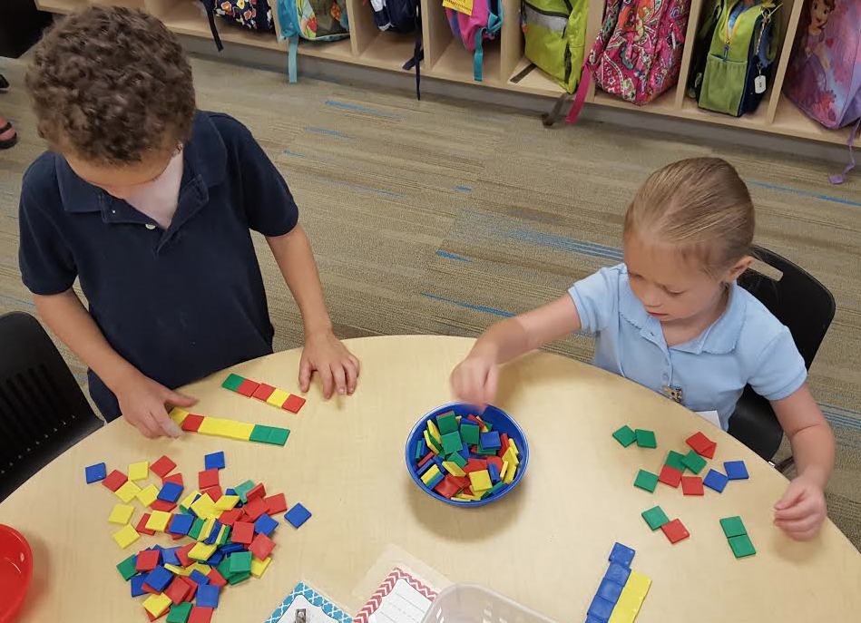
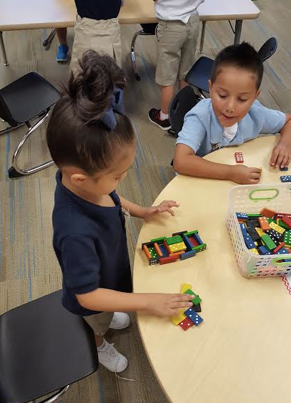
Classroom management
The 8 Expectations
Consistent rules and routines
Redirecting
Logical Consequences
Notes:
We start with the 8 Expectations each morning and refer back to them to encourage appropriate behavior. We use the Kindness Tree to encourage students to show kindness to their friends and to recognize when others are being kind. The Kindness Tree is a large tree on our wall that starts as a bare tree. We write acts of kindness on leaves and add them to the tree. By the end of the year the tree will be full!
Consistency- When kids know what to expect, behavior is better.
Redirecting- If a child is having a hard time handling an activity appropriately, we give warnings and then redirect to another activity.
Logical Consequences- Example-If a child continues to misuse scissors, they will lose the privilege of using scissors and will need to tear their paper instead (which is great for fine motor anyway ☺)

Slide 4
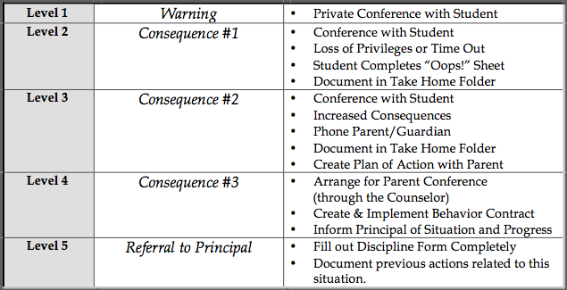
Creating a School Climate to Foster Learning and Creativity
Mrs. Melodie Fulmer
Dean of Students
School Wide Discipline Step Plan
Notes:
Mrs. Fulmer’s role at John Rex is to help guide us in creating a learning environment that is Safe, Respectful, and Responsible which is our Code of Conduct. We discuss with the students how walking on the right side of the stairwell, holding on to the railing is “Being Safe.” We talk about using quiet voices in the cafeteria is being respectful, and we discuss that taking ownership of our behavior is being responsible. With this code of conduct, we practice the procedures that go along with that. We practice walking in the hall, lining up for dismissal, and waiting in line in the cafeteria. These procedures, with practice, become routines….and good habits. For students that struggle with these procedures, we put them on a Discipline Step Plan to assist them in following procedures. Please notice that parents are not contacted until (give stem level) unless the infraction calls for it. We are trying to instill “self discipline” within our students to help them mature in to self-regulating adults.

Slide 5
Notes:
School Wide Learning Behaviors for Success.

Slide 7
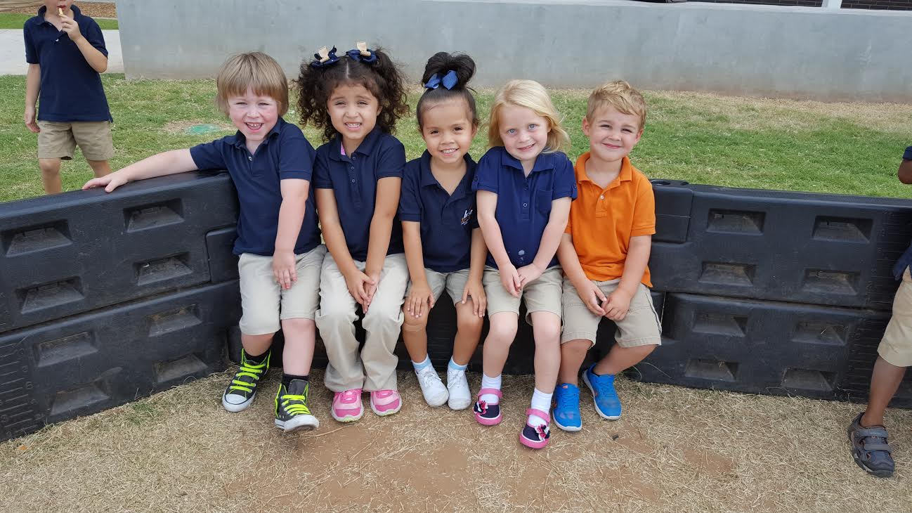
Prekindergarten Development
Cognitive: child’s ability to learn and solve problems
Social & Emotional: child’s ability to interact with others and to appropriately control his/her behavior
Speech & Language: child’s ability to understand and use language
Fine Motor: child’s ability to use small muscles, specifically hands and fingers to manipulate objects
Gross Motor: child’s ability to use large muscles

Slide 8
Math Perspectives PreK Curriculum
Emphasis on Developing Number Concepts
Balanced Instructional Settings:
Circle Time & Whole Group
Shared experiences
Exploration Time & Work Stations
Small Group – Guided instruction

Slide 9
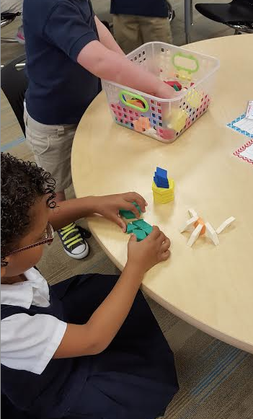
Pre-K Math Experiences
Number – finding out how many
Spatial – how shapes fit together
Pattern – what comes next
Measurement – making comparisons between objects
Data Collection – sorting and counting

Slide 10
Literacy Beginnings:
Create a classroom community that is play-based and prepares children for the literacy-rich world in which they live
Promotes constructive learning through inquiry
Support emerging readers and writers through an array of literacy activities
Notes:
Language is the most important cognitive tool for interpreting and explaining the information they (children) pick up as they explore and play.
Poems, Rhymes, Syllables, Vocabulary- reading aloud to your child and discussing stories is a wonderful way to build vocabulary.

Slide 11
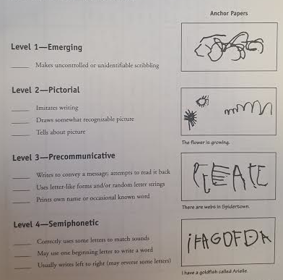
Itchy’s alphabet & kid writing
Notes:
We will learn the alphabet using a program called Itchy’s Alphabet. This program teaching letter sounds using pictures that resemble the letters. The kids will also learn to write the letters correctly with this program. Ex. The d is a dog with a tail, when they say this, the dog is drawn first. The b is a bat and a ball. The bat is first.
Kid Writing- When learning to write, students go through developmental stages. In PreK, our main purpose behind kid writing is to give the students the confidence to think of themselves as writers. Their writing may not look like adult writing but it’s okay because it’s Kid Writing. We demonstrate and model adult writing.

Slide 12
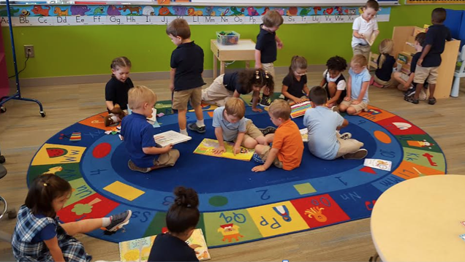
Teaching & Learning Daily Schedule
8:00-8:15 Table Time (Math Centers)
8:10-8:40 Morning Meeting & Songs
8:45-9:00 Recess
9:05-9:15 Calendar & Weather
9:15-9:25 Reading Time- Interactive Read-Aloud & Shared
9:25-9:45 Journal Writing
9:45-9:50 Share Time
9:50-10:10 Morning Centers (Literacy Centers)
10:10-10:25 Choice Time or Projects if time
10:30-11:20 Lunch & Recess
11:20-1:30 Rest time/ quiet reading time
1:30-1:45 Snack Time & Recess
1:45-2:40 Choice Time Centers
2:40-2:50 Closing circle
2:50-3:00 Prepare to go home

Slide 13
Parent Communication
Daily Folder- School Notes on Thursday
Weekly Newsletter
Class website: mrsstephensonJRCES.weebly.com
Sign Up Genius- Parent/ Teacher Conferences, Field Trips
Notes:
Daily Folder- please take all items out of daily folder pockets. Any papers in sheet protectors are to stay in the folder.
Weekly newsletters will come home in the Daily folders on Thursdays. I will also begin uploading the newsletter on my website for those who prefer electronic copies.
Class website- I will try to update this each week with the weekly newsletter, songs or activities from class, and other school and class information.

Slide 14
HOMEWORK
Read Daily
Familiar Books
Library Books
Talk about the stories
Homework Calendar starting in September
Notes:
Please read everyday! When your child wants to read the same book every night, do it! It will help your child to become a reader. They will “read” the book before they can really read. Reading those familiar books help your child with comprehension and fluency. Talk about the stories you read. Discuss: beginning, middle, and end; characters- who was in the story?; what ifs- how would it be different if this character wasn’t in the story?; make connections to other books or real life experiences.
A homework calendar will be in the front of your child’s Daily folder, starting next week! Initial each day as homework is complete. Examples of homework- Shape Hunt- How many squares can you find?; Tell 3 people your full name. The blank paper added to the Daily Folder is for any homework that may involve drawing a picture.

Slide 15
WALKING FIELD TRIPS
Where?
Library- Thursdays at 9:00 (leaving school at 8:40)
Starts in October
Myriad Gardens- Nature Walk, Playground, Feeding the ducks, visit the Crystal Bridge, themed events
Museum of Art
How?
Sign Up Genius for Chaperones & Guests

Slide 16
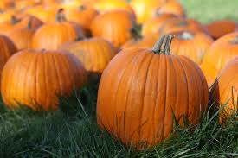
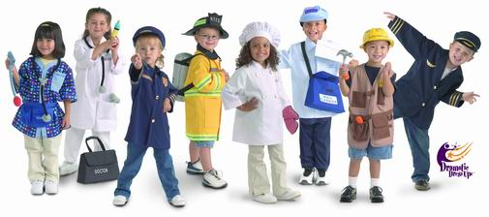
SCIENCE & SOCIAL STUDIES
Upcoming Units…
Pumpkins
Community Helpers
Notes:
In the fall, we will study pumpkins. We will cut into pumpkins, count seeds, taste roasted pumpkin seeds and taste other pumpkin treats. We will compare different types of pumpkins. We will learn about the life cycle of a pumpkin and even watch our pumpkins rot. During our Community Helpers unit, we will role play as community helpers and have real life community helpers come to the classroom. To end the unit, we will need parent volunteers to help us create community helper vehicles out of moving boxes!

Slide 18
THANK YOU FOR COMING!!!!

